Slide 1
The Future Of jobs
And the Digital Skill Gap…

Slide 2
Current Trends
Personal Assistants
Chat Bots
Self Driving Cars
DNA Analysis
Drones
Smart Devices…

Slide 3
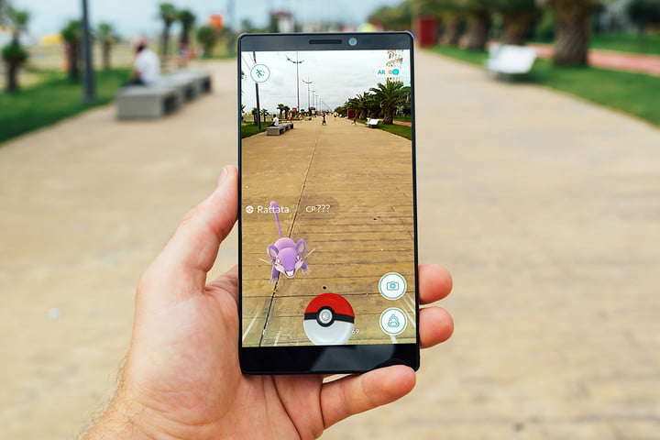

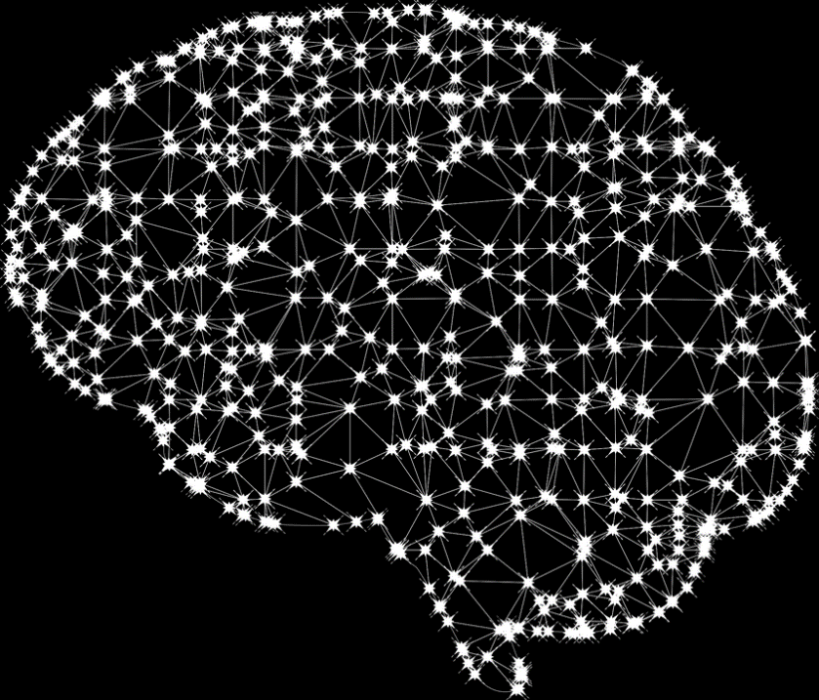
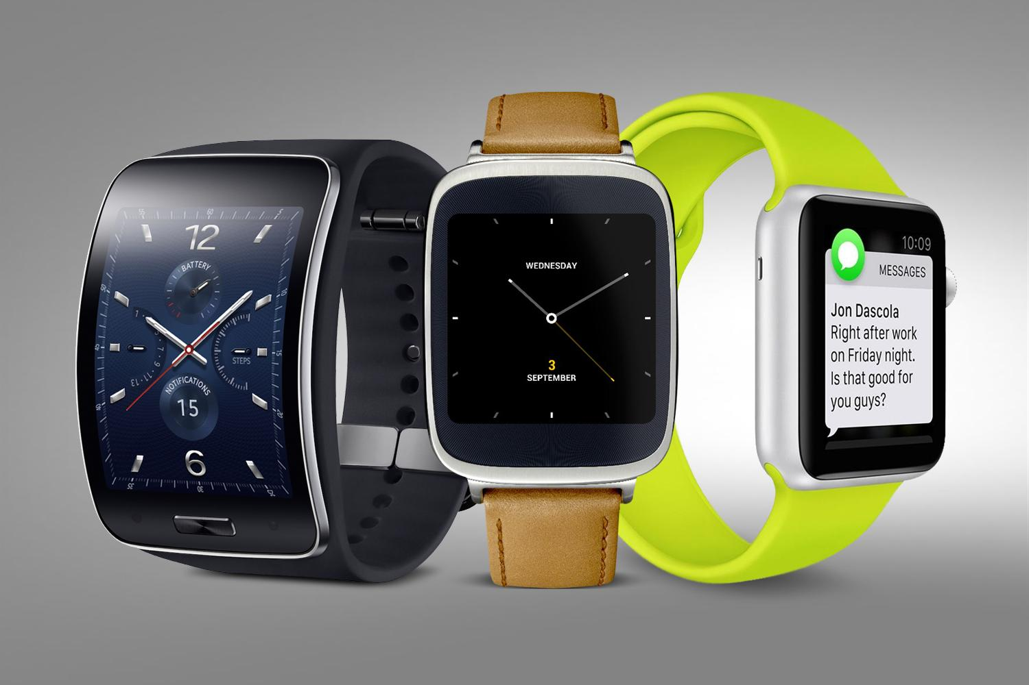
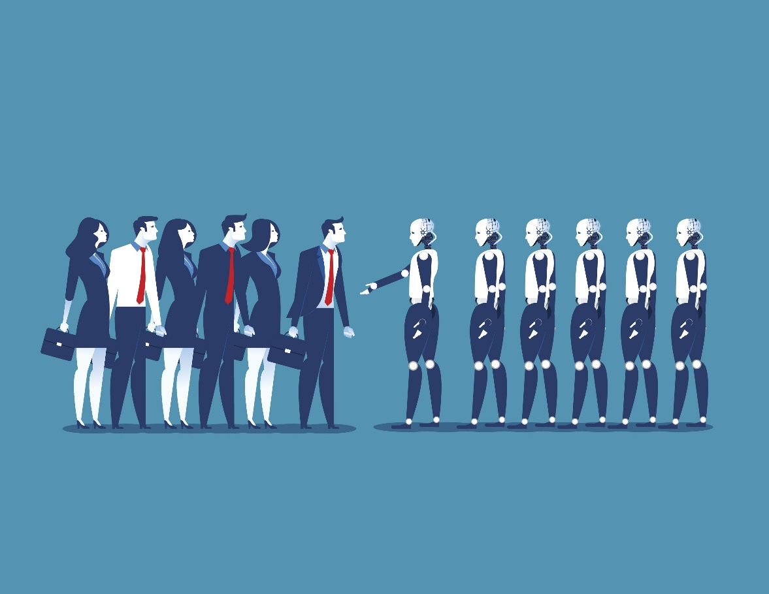

What will 2020 look like?

Slide 4
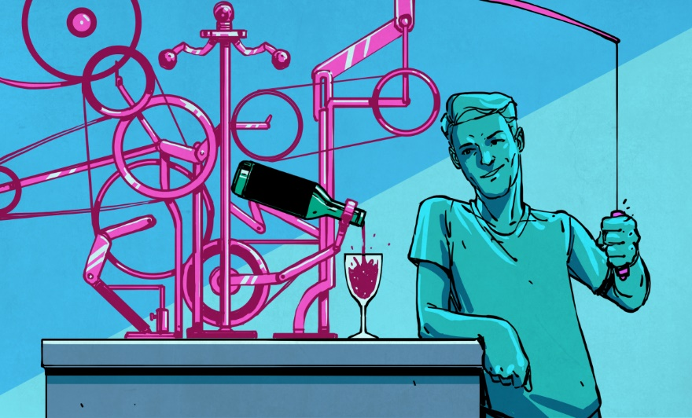
45% of the jobs are going to get Automated

Slide 5
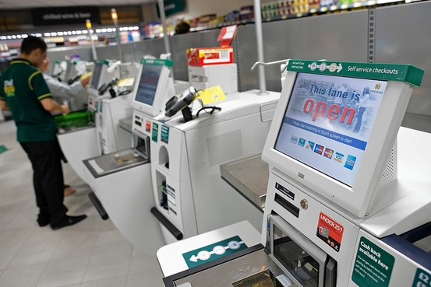
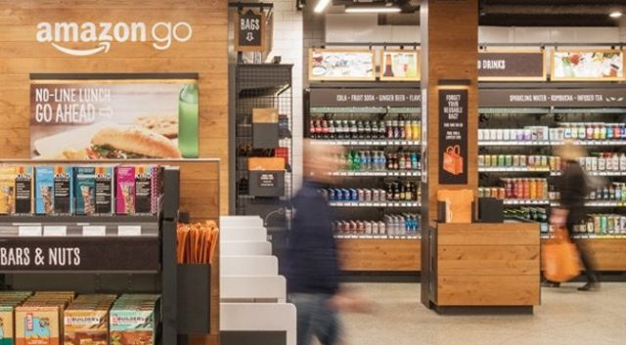
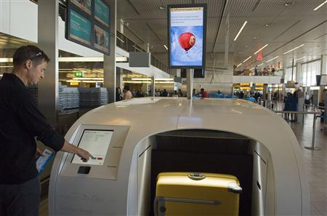
On Average 33% of Jobs in 2020 don’t exist yet

Slide 6
Think Again
In 2012 there were 150000 people working at Wall st.
Automation cut that down to 100000
1/3 Gone

Slide 7
Journalists
Tax Consultants
Marketeers
Technicians
Knowledge Workers
Lawyers
ME!!!

Slide 8

And what have you been doing??
And the problem is Machines don’t wait or watch Netflix…

Slide 9
So what are the forces in play here?
Basically there are 10 million programmers out there using increasingly simple and cheap technologies to build new products and services
Heck, some are even 12
Startups eating away jobs
Are they creating any jobs in the process?

Slide 10

Kodak
Worth $38 Billion and employed 140000 people
i.e. $270000/employee

Slide 11

YouTube
Sold for $1.65 Billion with mere 65 employees
That’s $25 Million/employee

Slide 12

Instagram
Having 13 employees sold for $1 Billion
That’s $77 Million/employee

Slide 13

WhatsApp
Sold for $19 Billion with 55 employees
That’s $345 Million/employee

Slide 14
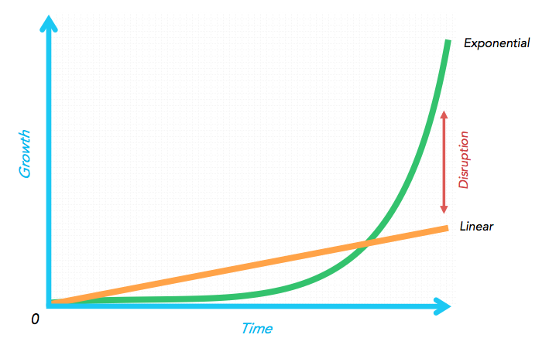
How is this possible? Technology has allowed the emergence of Exponential Organizations Leverage Technology Less Employees More Tech Savvy ones

Slide 15
Jobs will be Replaced by SKILLSETS Master the fundamentals and you can master the Rest You are Irrelevant Your SKILLS are

Slide 16
Lets talk Skills…
Data Handling
App Development
Intelligence
Cyber Security
Online Money

Slide 17
Data Handling
Forms of Data:
Files
RDBMS
NoSQL

Slide 18
App Development
1 : Different apps for different platforms
2 : One app different platforms
React Native by Facebook
Progressive web apps by Google
Backend platforms : Python, NodeJS, etc.

Slide 19
Intelligence
Machine Learning
Deep Learning
Artificial Intelligence

Slide 20
Cyber Security
Vulnerability Assessment
Penetration Testing
Malware Analysis/Reverse Engineering

Slide 21
Online Money
Centralized Ledger
Distributed Ledger
Decentralized Ledger

Slide 22
How to start? How about Python…
Batteries Included
Multi-Purpose
Readable
Cross-Platform
Object Oriented, Functional, Reactive, bring it on…

Slide 23
Let’s see something cool…

